Slide 1
Scheduling in Smart Grids
-Arun Srikantha
-Divya Pathak
-Harsha Panjwani
-Varun Pillai
-

Slide 2
What is Smart Grids ?
An optimal energy scheduling policy that considers the varying demands in a particular residential neighborhood as well as minimizes the total cost which is necessary in the present situation where global energy resources are limited

Slide 3
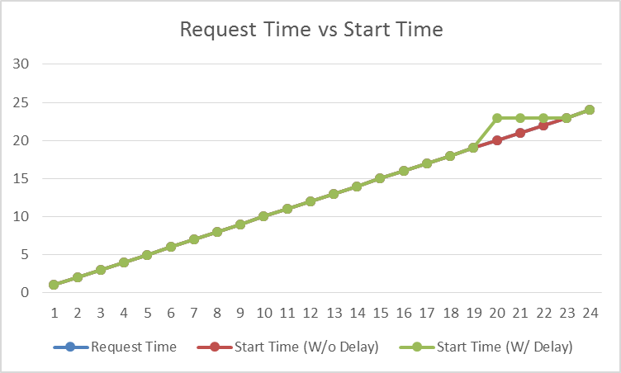
Base case Scenario

